Slide 1


What to do if you have a splash/sharps injury
Occupational health guide for NIAS staff

Slide 2
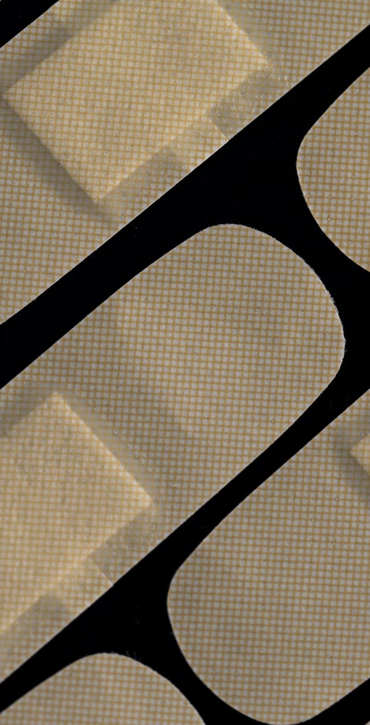
Immediate First Aid
Sharp injury
Wash liberally with warm water and soap (not antiseptic)
Encourage bleeding (should not be sucked!!)
Dry and cover with plaster
Splash (exposure to eyes, nose or mouth)
Irrigate area for at least 5 minutes
Do not remove contacts until irrigation complete

Slide 3
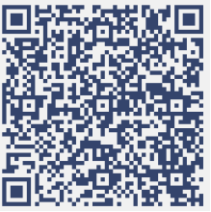
Ongoing follow up
ALL incidents must be reported to Occupational Health regardless of time of the day.
Occupational Health can be contacted for sharps/splash injuries via:
Sharps helpline 02891652255
Completion of MS Form accessed via the QR code
Sharps and splash injuries are self referrals – do not ask your line manger to refer you to OH. This will result in a delay for follow up by OH.

Slide 4
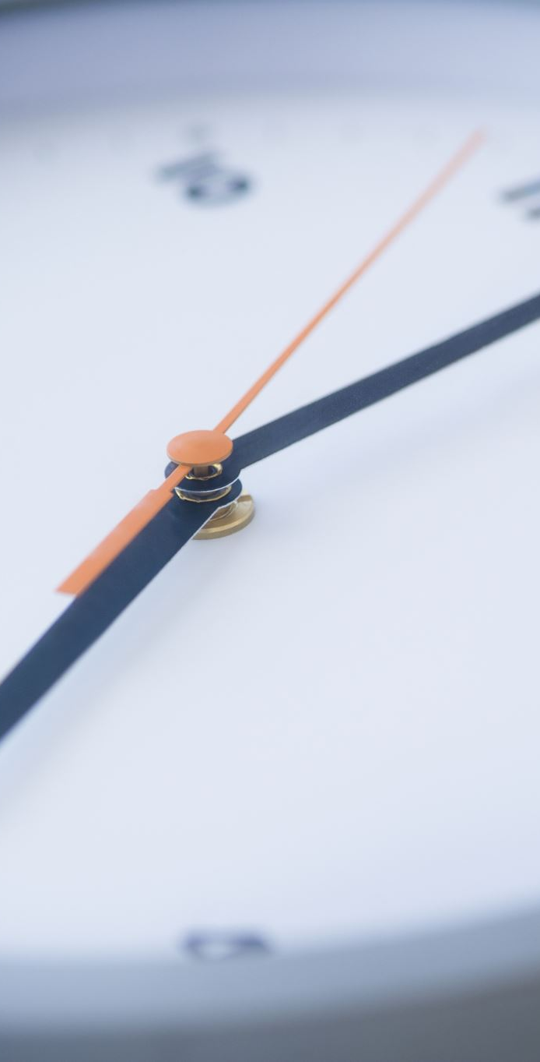
In Hours
Monday –Friday between 8am and 4pm (excluding bank holidays)
You must contact the OH team as previously described. OH will arrange further follow up as required.
You must advise EOC who will facilitate downtime while you contact OH / are assessed in ED. Staff must remain in regular contact with EOC throughout.
Ensure your line manger is aware
Complete Datix reporting

Slide 5
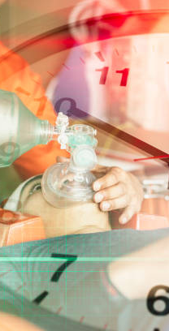
Out of Hours
Contact OH leaving either a voicemail (with your contact details) or completing the MS form via the QR code. The OH nursing team will contact you the next working day.
Advise EOC who will facilitate downtime while you contact OH / are assessed in ED. Staff must remain in regular contact with EOC throughout.
Book on in ED who will provide immediate support in the form of risk assessment, take bloods if required or prescribe prophylaxis.
Ask ED staff to complete the MS form with details the treatment YOU received- it is available on the QR code on the sharps poster
ED staff will not provide on-going support or advice – this is the function of the OH team.

Slide 6
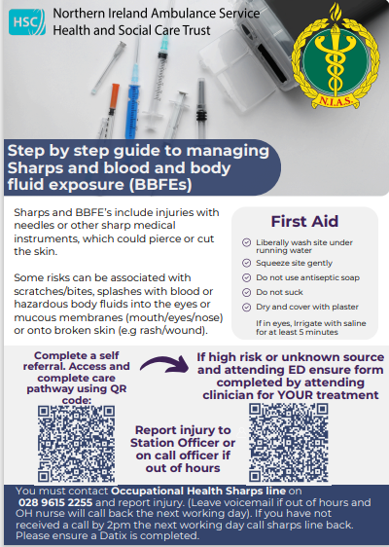
Sharps poster must be displayed in all stations and welfare facilities.
Available on the IPC resource under additional resources.

Slide 7

Points to remember
Prevention is better than cure:
Manage sharps safely
Do not resheath needles
Do not overfill sharps containers
Wear face and eye protection if there is a risk of splash
Always report any sharps or splash incidents to OH directly, your line manger and via Datix.

Slide 8
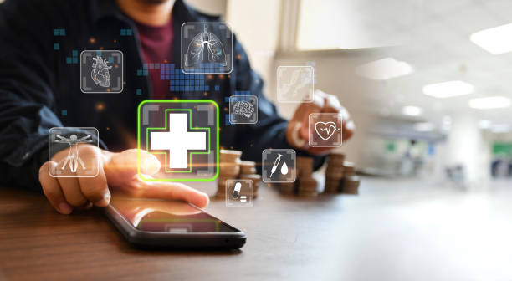
Points of contact
Suzie McCullagh is the contact for NIAS OH if need assistance during normal working hours.
suzie.mccullagh@belfasttrust.hscni.net
PLEASE DO NOT REPORT SHARPS VIA THIS EMAIL
Do not send urgent queries to this email.

